Slide 1
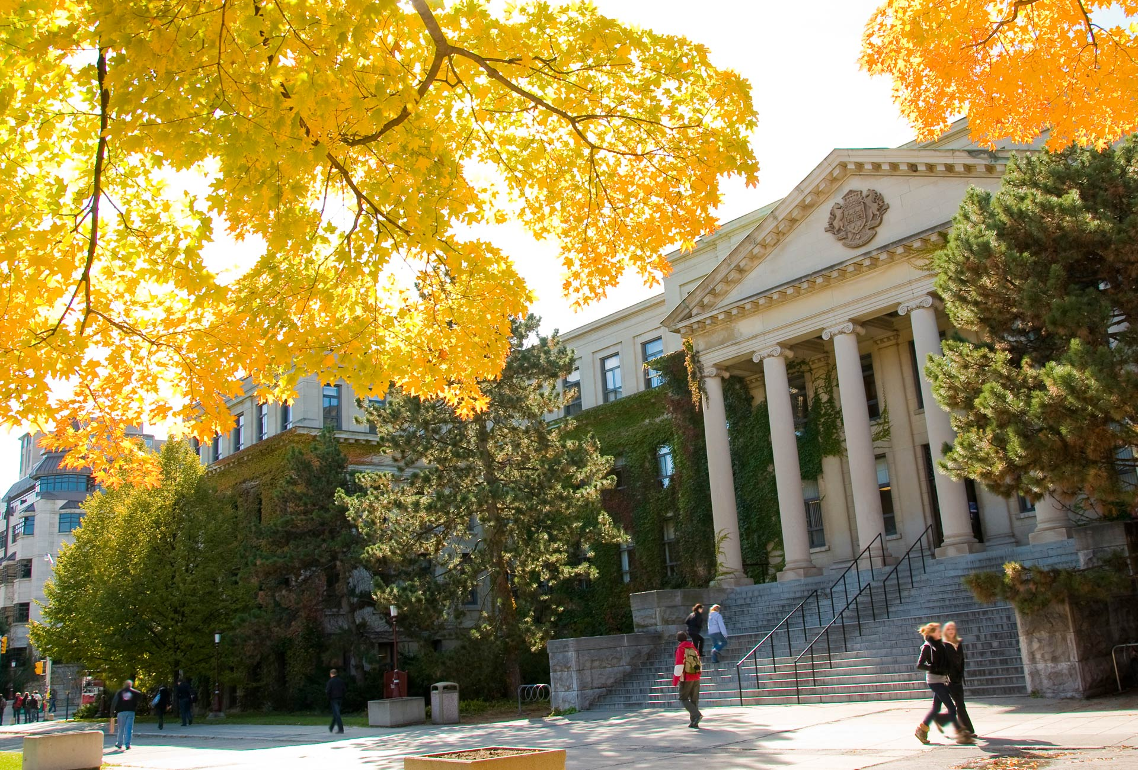

3+2 Collaborative Programs
Faculty of Engineering, uOttawa
uOttawa.ca
Notes:
PAGE COUVERTURE (option 1)
REMARQUE : À lire avant d’utiliser le gabarit
Les éléments suivants du gabarit ne peuvent pas être modifiés :
• En-tête institutionnel grenat (Université d’Ottawa | University of Ottawa)
• Pied de page institutionnel comprenant la bande grise et grenat ainsi que le logo
Les éléments suivants du gabarit peuvent être modifiés :
• L’adresse Web uOttawa.ca dans le pied de page peut être personnalisée afin de répondre aux besoins de l’utilisateur et le nom du document peut être inséré à la droite de l’URL si nécessaire. Vous pouvez simplement taper l’adresse Web désirée dans la boîte appropriée
• La photo ou l’image de fond peut être remplacée par celle de votre choix
COVER PAGE (option 1)
NOTE: Read before using template
The following elements of the template must remain untouched and cannot be modified:
• Corporate (Université d'Ottawa | University of Ottawa) garnet header
• Corporate uOttawa footer including the grey/garnet stripe and logo
The following elements of the template may be customized:
• You may include the uOttawa.ca URL of your choice in the footer, and insert the name of the document to the right of the URL, if needed
• The URL can be customized to a specific URL by following these simple steps: On the PowerPoint View tab, in the Master Views group, select Slide Master. Select the third slide on the left side panel, and type in the desired URL on the slide
• The photo or background image may be replaced by the photo or background image of your choice

Slide 2
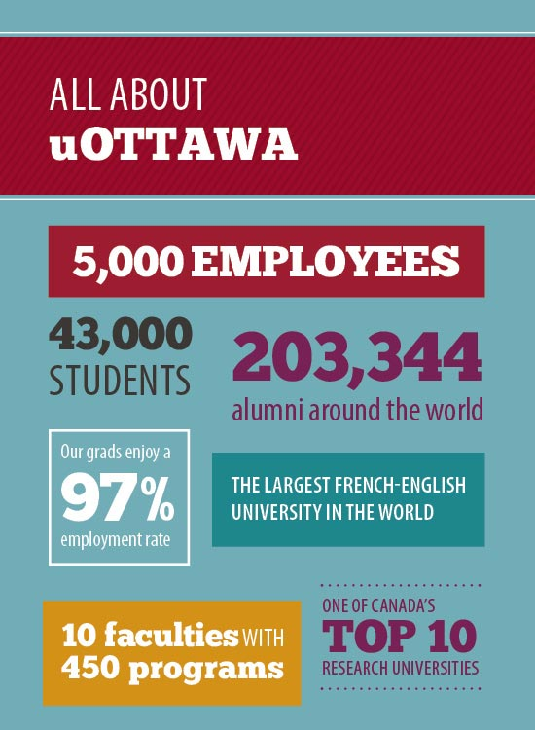

Founded in 1848
The largest bilingual (English- French) comprehensive university in the world
Member of the Group of 15 research-intensive universities (U15) and several other national and international associations.
More than 43,000 students:
  4,500 master’s
  1,900 PhD
  5,500 international students

Slide 3



The University of Ottawa in Rankings
#1 Ranking in 2017 QS Top Universities “Top 10 Student Cities – According to Students”

Slide 4
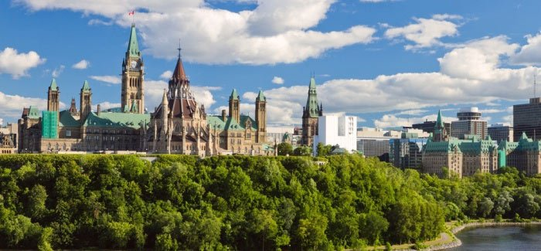
Did You Know?
Ottawa-Gatineau is the 5th largest metropolitan area in Canada
Ottawa was deemed Canada’s Best Place to Live in 2017, as measured by quality of life indexes. This honour was also bestowed in 2016
Ottawa is one of Canada’s most respected tech hubs with 1750 knowledge-based companies and nearly 72,000 jobs

Slide 5
International students on campus from China
 | Faculty | Total
Graduate students | ARTS | 16
 | LAW | 7
 | EDUCATION | 16
 | ENGINEERING | 251
 | MANAGEMENT | 8
 | MEDICINE | 5
 | SCIENCE | 38
 | HEALTH SCIENCES | 2
 | SOCIAL SCIENCES | 55
 | SPECIAL STUDENTS | 8
 | Total | 406
 | Faculty | Total
Undergraduate students | ARTS | 114
 | ENGINEERING | 268
 | MANAGEMENT | 317
 | SCIENCE | 167
 | HEALTH SCIENCES | 13
 | SOCIAL SCIENCES | 260
 | SPECIAL STUDENTS | 45
Total Undergraduate |  | 1184
Grand total |  | 1592

Slide 6
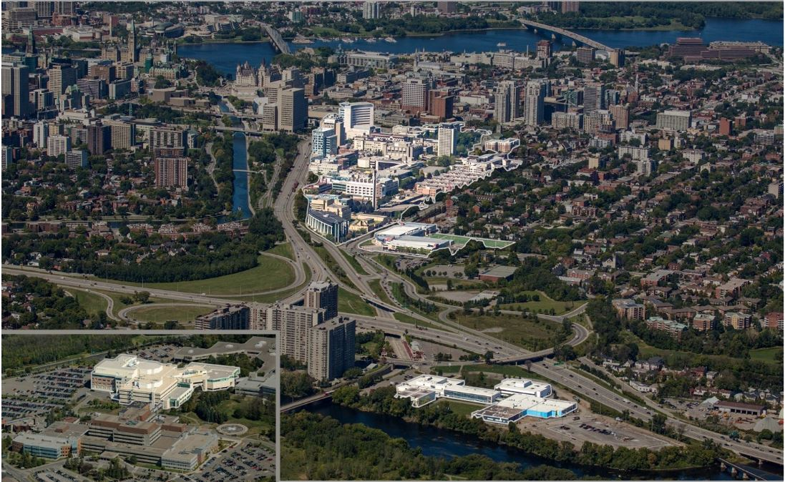
GATINEAU, QC
Parliament Hill
Byward Market
MAIN CAMPUS
Downtown Ottawa
Sandy Hill
Lees Campus
ROGER GUINDON
(Medicine/ Health sciences)
Our campus
Our Campus

Slide 7
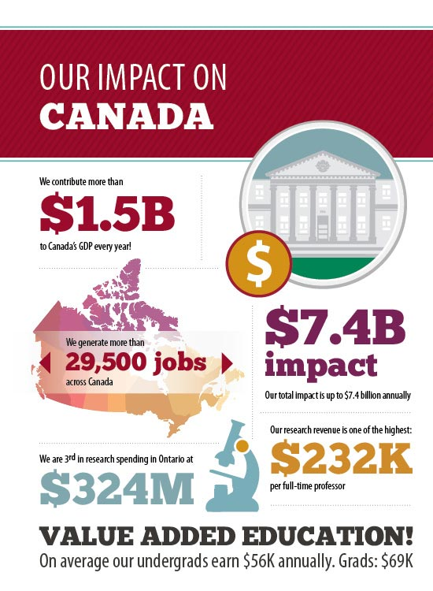


Slide 8
International Office
international.uOttawa.ca
The international Office offers advice and support to students, faculty and staff, from uOttawa and international institutions, on all aspects of international engagement.
International Student Mentors are available at the International Student Success Centre (ISSC) to answer questions regarding:
  Canadian culture
  Academic life
  Learning strategies
  Other challenges you might face.

Slide 9
Student Academic Success Services (SASS)
  SASS is a free network of services and programs designed to give you the tools and information you need to succeed.
  Getting help from Student Academic Success Service:
    http://sass.uottawa.ca/en
  They offer counseling, mentoring, exam services for accommodations, and access to students in need, for free!

Slide 10

Faculty of Engineering

Slide 11
Faculty of Engineering by the numbers
Undergraduate (UG) enrolment (2018): 4,500
incl. International Students Over 1,100
Graduate (G) enrolment (2018): Over 1,500
incl. International Students Over 1,100
Regular full-time professors: 128
Regular support personnel: 90
Buildings and facilities (44% research labs): 21,540 m²

Slide 12
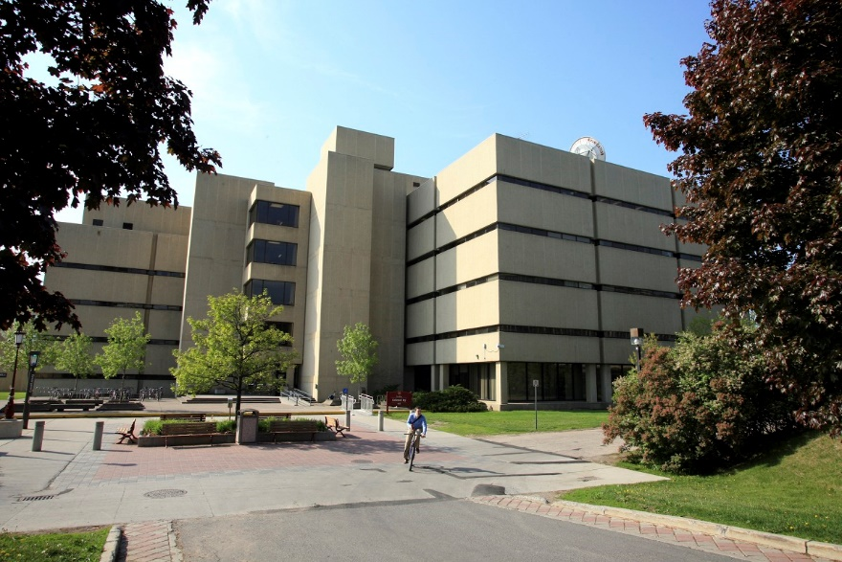
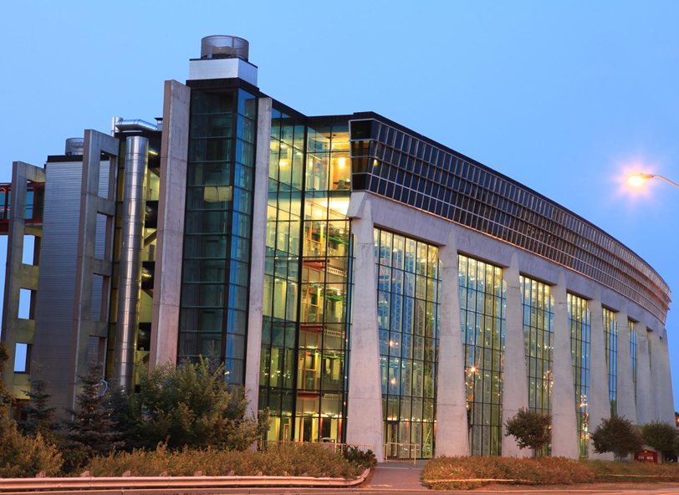
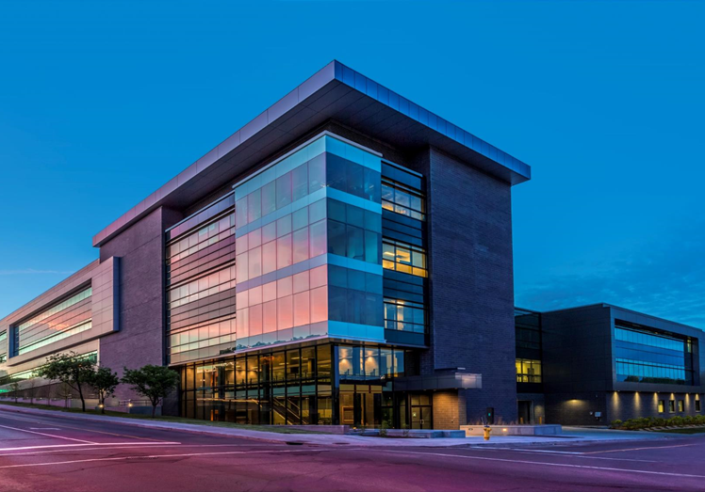
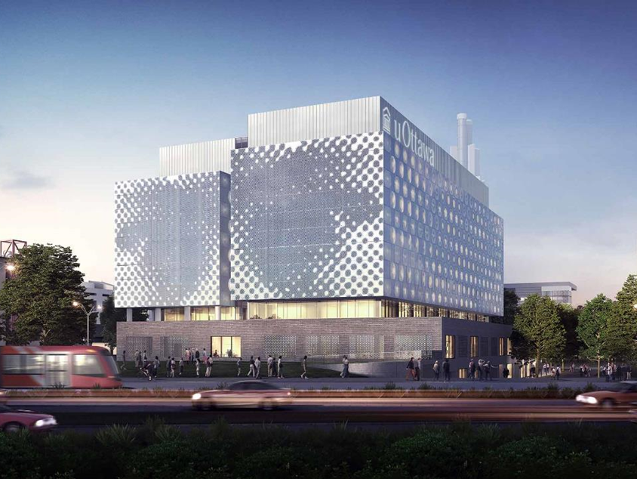
Colonel By
SITE
Chemical & Biological Engineering
Civil Engineering
Mechanical Engineering
Electrical Engineering and Computer Science
Advanced Research Complex
New STEM Complex
Centre for Advanced Materials Research (CAMaR)
Photonics
Centre for Entrepreneurship and Engineering Design
Civil Engineering
Mechanical Engineering

Slide 13





Five Strategic Research Themes of the Faculty
Enabling Technologies for Health Care and Augmented Life
Technology for Digital Transformation of Society
Sustainable and Resilient Infrastructure
Emerging Materials and Processes: Design and Development
Photonics for Devices,
Networks and Energy
• Biofeedback and well-being
• Biomedical engineering
• Biomechanics
• Health informatics
• Business processes for healthcare
• Biomedical signal processing
• Biosensors, instrumentation and devices
• Data mining and public health
• Artificial Intelligence, Robotics and Autonomous Systems
• Communications Networks and Services
• Internet of Things/Machine-to-Machine Systems
• Advanced Data Management and Analytics
• Cybersecurity
• Human Interaction with Digital Media
• Software Engineering
• Text Mining and Machine Learning
•Natural and human-induced hazard mitigation
•Physical and cyber infrastructure protection and security
•Smart infrastructure
•Infrastructure rehabilitation
•Building information modelling and visualization
•Life cycle analysis and lean construction optimization
•Climate change
•Water security
•Advanced and/or sustainable construction materials
•Smart cities
•Renewable energy
•Efficient vehicles
• Nanomaterials
• Composite Materials
• Additive Manufacturing
• Sustainable Materials
• Biomedical Materials
• Electronic Materials
• Reactor Design
• Optimization, Modeling & Process Control
• Solar energy
• Biophotonics
• Microwave photonics
• Plasmonics
• Quantum photonics
• Fibre optics
• Optoelectronics
• Optical materials

Slide 14


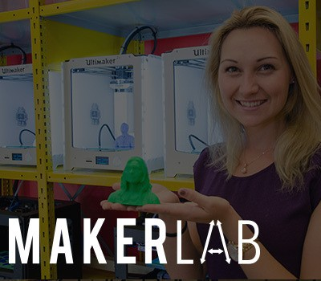



Centre for Entrepreneurship and Engineering Design
Simon Nehme Design Commons
The Simon Nehme Design Commons is a new reconfigurable space that fosters creativity and ideation for students involved in design or entrepreneurship.
Richard L’Abbé Makerspace
The first uOttawa invent-build-play space featuring 3D printers, arduinos, 3Dscanners, embroidery machines and Laser Cutters.
~ 1500 users/year
MakerLab
Provides students with a structured learning experience using technologies available at the Makerspace.
~ 800 users/year
The Brunsfield Centre
Engineering students can design, fabricate, and test complex prototypes.
~ 250 users/year
Manufacturing Training Centre (MTC)
Provides training on traditional mechanical equipment such as lathes, milling machines and saws.
~ 800 users/year
John McEntyre Team space (JMTS) Provides pre-competitive teams involved in large-scale projects with the space and infrastructure required to succeed.
~ 200 users/year

Slide 15




Extra-Curricular Programs
Simon Nehme Summer Entrepreneurship School
The week long summer school with an intensive program each day featuring 17 speakers and 8 mentors.
Resulted in 6 business concepts and collaboration between different faculties.
Difference Makers Program
This program offers students the opportunity to identify and act upon their vision for creating positive change.
Wide range of extracurricular activities and workshops meant to teach creative problem solving skills to the development of sustainable solutions, products, services and organizations.
300 students access the workshops each year.
Entrepreneurship Internship
Internships are in existing start-ups or to support students in starting their own companies.
20 entrepreneurship internships were offered last year.
Start-up Weekend
Hosted Start-up Weekend uOttawa edition. Over 30 judges and mentors.
Around 100 students participated in the event.

Slide 16
Academic Programs at the Faculty of Engineering
UNDERGRADUATE
Biomedical Mechanical Engineering
Biotechnology
Chemical Engineering
Civil Engineering
Computer Engineering
Computer Science
Electrical Engineering
Mechanical Engineering
Physics and Electrical Engineering
Software Engineering
GRADUATE
Advanced Materials and Manufacturing
Biomedical Engineering
Chemical Engineering
Civil Engineering
Computer Science (incl. concentration in Applied AI and specialization in Bioinformatics)
Electronic Business
Electronic Business Technologies
Electrical and Computer Engineering
Engineering Management
Environmental Engineering
Mechanical Engineering
Systems Sciences

Slide 17
3+2 programs
Successfully complete the first 3 years of your Bachelor’s degree at your home institution
Apply for graduate programs at uOttawa Faculty of Engineering and get pre-admitted to a course-based Master program (M.Eng., M.C.S. or M.E.B.T.)
Study at uOttawa Faculty of Engineering in the 4th year of your undergraduate program
Get awarded a Bachelor’s degree by your home institution
Study as a graduate student at uOttawa Faculty of Engineering
Get awarded a Master’s degree by uOttawa
Note: Program participants receive 10% discount for tuition fees

Slide 18
Authorised 3+2 Admission Partner in China
Dongfang International Center for Educational Exchange
http://www.cscdf.org
Shandong branch:
RoomC806, Wanda Plaza, No.5 Jingsi Road,
Shizhong District, Jinan, Shandong, 250001, China
Phone: +86-531-55709866-8011
Beijing branch:
16th Floor, Dacheng Plaza, No. 127A, Xuanwumen Xidajie
Beijing 100031, China
Phone: +86-10-66411821-605
Only candidates who have applied through this agency can be considered for the 3+2 program

Slide 19
Application process
Eligibility
Language requirements
Documents Required for Admission
Our Programs in great detail:
http://catalogue.uottawa.ca/en/programs/#filter=.filter_20&.filter_24&.filter_30
Apply Now link:
https://www.ouac.on.ca/apply/ottawagrad/en_CA/user/login
The most accurate and up to date information on application deadlines, language tests and other admission requirements:
https://www.uottawa.ca/graduate-studies/programs-admission/apply/specific-requirements

Slide 20
Application Process
Please read the following information to help you prepare for submitting your application for graduate studies: https://www.uottawa.ca/graduate-studies/programs-admission/apply#apply-now
The application process is done entirely online.
Note that you will be required to pay a non-refundable application fee ($100) when submitting your application
The Official Deadline to apply is before or by January 31st, 2020.
(!) Remember:
  it can take six months to obtain a study permit;
  there is no deferral option

Slide 21
Application process
Language requirements:
    Language tests recognized by the University of Ottawa:
    TOEFL: Depending on the program: 550 (Paper-based) or 79-80 (Internet-based); 570 (Paper-based) or 88-89 (Internet-based);
    or
    IELTS Academic: Overall 6.5 (for M.E.B.T. – 7.0);
    or
    An equivalent language test.
    Note: Candidates are responsible for any fees associated with the language tests.

Slide 22
Language Assessment + Interviews
Alternatively to IELTS/TOEFL, students may opt to complete a CanTEST language proficiency evaluation administered by the University of Ottawa in China
Prior to applying to uOttawa, participating students will be interviewed by the uOttawa Faculty of Engineering liaison officer. Interviews will serve to assess academic progress, interest and language proficiency, etc.
Preliminary dates for language assessment trip and interviews are between November 25th and December 10th, 2019
The completion of the English Intensive Program (EIP) at uOttawa prior to the start of the Fall semester is a program requirement and a language test cannot replace the EIP

Slide 23
Application process
Documents Required for Admission (for specific program requirements, please consult https://www.uottawa.ca/graduate-studies/programs-admission/apply/specific-requirements)
A Resume;
A Letter of Intent (Letter outlining your professional goals and proposed research area) (for M.C.S.)
Two confidential Letters of Recommendation from professors who have known the applicant and are familiar with their work;
  You are strongly encouraged to contact your referee(s) prior to submitting your application in order to confirm their email address and their availability to complete your letter of recommendation;
Transcripts from all universities attended:
  You must submit official transcripts from all the universities you have attended (w/ grading scales);
  This applies to all courses and programs at any university you attended, including regular programs (completed or not), exchanges, letters of permission, online or correspondence courses, courses taken as a special student or visiting student, etc.;
  If the transcript and degree certificate are not in English or French, a certified translation (signed and stamped/sealed) must be submitted

Slide 24
Additional Notes:
Documents that are not required for admission will not be consulted, conserved or returned to the student
Some programs may require additional documents
All required documents are to be submitted electronically. Once you have submitted your application and it has been transferred to uOttawa’s servers, you will receive an email with instructions on how to access uoZone. Once you have logged in, you must go in the "Applications" section to have access to the uoDoc: Upload Admissions Documents application where you will be able to upload your documents
Documents will NOT be accepted by e-mail

Slide 25
For more information on Admission and Academic Related questions:
Graduate Studies Office of the Faculty of Engineering
e-mail: engineering.grad@uottawa.ca
Remember to include in your email:
      to the att. of Chase Van Dusen
      Your full name
      3+2 program
      Application or student number
Web-page: https://engineering.uottawa.ca/graduate-programs
Address: 800 King Edward, SITE Building, room 1024, Ottawa, Ontario, Canada K1N 6N5

Slide 26
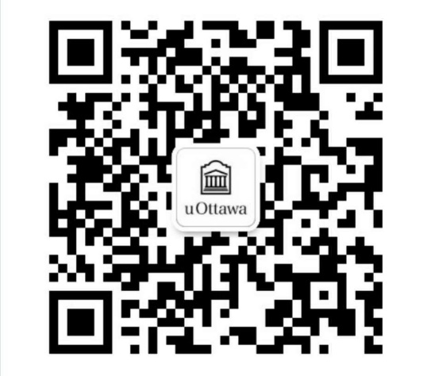
For more information on Other questions:
International Affairs Office of the Faculty of Engineering
Tel: 613-562-5800 ext. 6508
e-mail: engineering.international@uOttawa.ca
Address: room A332, 161 Louis Pasteur, Ottawa, ON, Canada, K1N 6N5
Add us in WeChat!
WeChat ID: UOEngInt

Slide 27
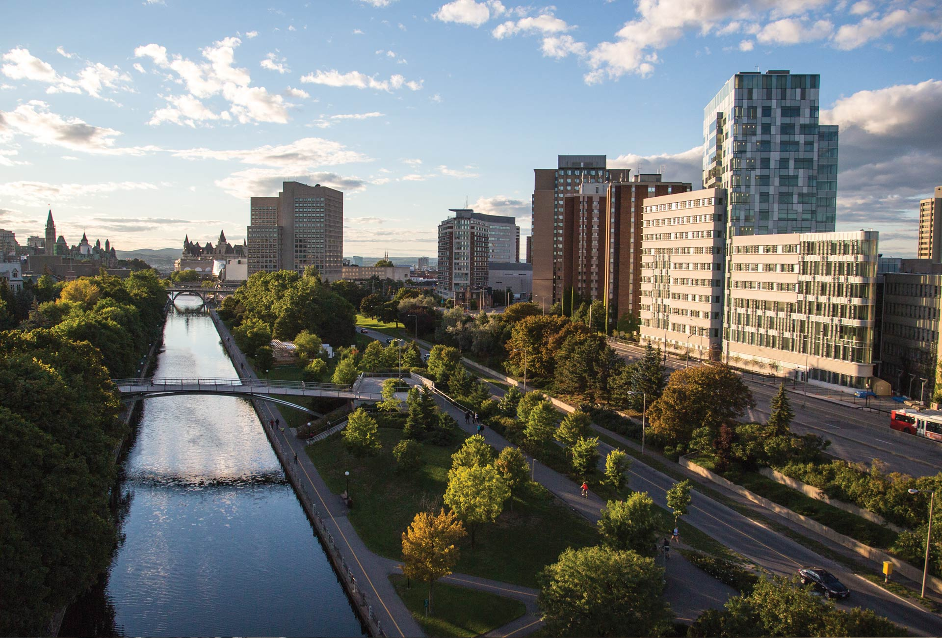
Thank you!
We look forward to seeing you on campus soon!
uOttawa.ca
Notes:
PAGE COUVERTURE (option 2)
REMARQUE : À lire avant d’utiliser le gabarit
Les éléments suivants du gabarit ne peuvent pas être modifiés :
• En-tête institutionnel grenat (Université d’Ottawa | University of Ottawa)
• Pied de page institutionnel comprenant la bande grise et grenat ainsi que le logo
Les éléments suivants du gabarit peuvent être modifiés :
• L’adresse Web uOttawa.ca dans le pied de page peut être personnalisée afin de répondre aux besoins de l’utilisateur et le nom du document peut être inséré à la droite de l’URL si nécessaire. Vous pouvez simplement taper l’adresse Web désirée dans la boîte appropriée
• La photo ou l’image de fond peut être remplacée par celle de votre choix
COVER PAGE (option 2)
NOTE: Read before using template
The following elements of the template must remain untouched and cannot be modified:
• Corporate (Université d'Ottawa | University of Ottawa) garnet header
• Corporate uOttawa footer including the grey/garnet stripe and logo
The following elements of the template may be customized:
• You may include the uOttawa.ca URL of your choice in the footer, and insert the name of the document to the right of the URL, if needed
• The URL can be customized to a specific URL by following these simple steps: On the PowerPoint View tab, in the Master Views group, select Slide Master. Select the third slide on the left side panel, and type in the desired URL on the slide
• The photo or background image may be replaced by the photo or background image of your choice

